Slide 1
Unit 9
What does he look like?
Section A Grammar Focus-3d
七年级(下)

Slide 2
Grammar Focus
What does he look like? | He’s really tall.
What does she look like? | She has long straight hair.
Do they have straight or curly hair? | They have curly hair.
Is he tall or short? | He isn’t tall or short. He’s of medium height.

Slide 3
阅读Grammar Focus部分，
完成下列句子。
1. 他长的什么样子？_____________________
2. 他个子很高。_______________
她长的什么样子？_____________________
4. 她有一头长直发。_____________________
5. 他们长的什么样子？___________________
What does he look like?
He is really tall.
What does she look like?
She has long straight hair.
What do they look like?

Slide 4
6. 他们是直发还是卷发？
_________________________________
7. 他们是卷发。_______________________
8. 他个头高还是矮？____________________
9. 他不高也不矮。他是中等身高。____________________
____________________
Do they have straight hair or curly hair?
They have curly hair.
Is he tall or short?
He isn’t tall or short.
He’s of medium height.

Slide 5

探究乐园
一、描述人物外貌的问句。
1. 她/他长得什么样子？
What does he/she ____ ____?
2. 他们长得什么样子？
What ___ they ____ ____?
3. 她个子是高还是矮？
__ she tall __ _____?
4. 他是长发还是短发?
_____ he have ____ __ short hair?
look like
do look like
Is or short
Does long or

Slide 6
二、描述人物形象的表达方式。
1. 描述身高、体重等整体特征时用be动词。
如：
他很高/矮/中等身高。
He ___ tall/ _____/ ___ ________ height.
她长得很瘦/胖。
She ___ thin/ _____.
2. 表示留着何种发型等用have/has。
她留着长的直发。
She ____ long ________ hair.
is short of medium
is heavy
has
straight

Slide 7
3. 表示穿着、戴着眼镜（帽子）用wear。
他戴着一幅眼镜。
He _____ a pair of _______.
三、选择疑问句。
用法：列举出两个可能情况让对方选择回
答的疑问句。答语不能用Yes/No，常选择
其一来回答句子结构： 一般疑问句 + ___
+ 第二个选项?
wears glasses
or

Slide 8
1. 他是直发还是卷发？
____ he have _______ hair __ ____ hair?
他长着黑色的卷发。
He has _____ _____ hair.
2. 她长得是胖还是瘦？
__ she thin ___ _____?
她长得有点瘦。
She is a ______ _____.
Does straight or curly
black curly
Is or heavy
little thin

Slide 9
Words and expressions
captain 队长 team 球队
popular 流行的 blonde 金发的
good-looking 好看的, 漂亮的
bit 一点儿 joke 笑话
a little bit 有一点儿
brown 棕色的
never 从不, 永不, 未曾

Slide 10
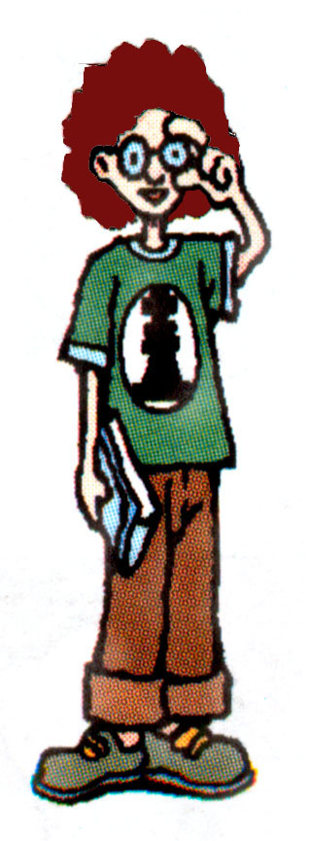
Mike is a good student.
He’s very tall.
He has curly brown hair and
is of medium build. He likes
reading and playing chess.

Slide 11
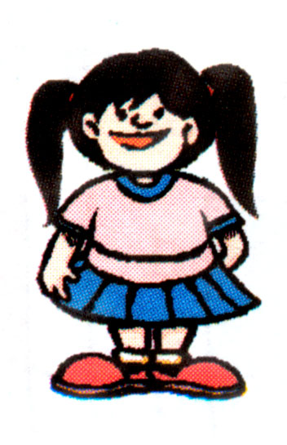
Xu Qian loves to tell jokes.
She’s short and a little bit
heavy. She has beautiful
long black hair. She never
stops talking!

Slide 12
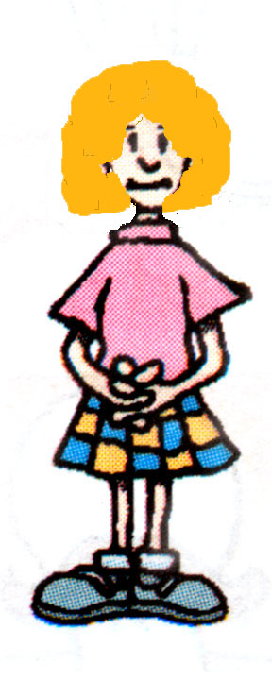
Mary is thin and she is of
medium height. She has curly,
blonde hair. She’s good-looking
but she’s a little bit quiet.

Slide 13
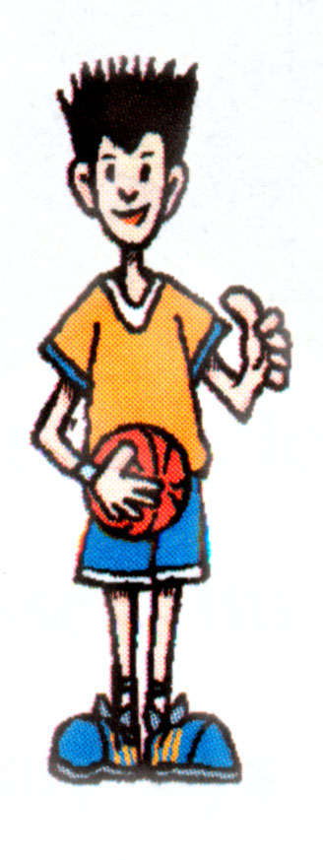
Wang Lin is the captain of
the basketball team. He’s
tall. He has short, straight
hair. Wang Lin is very
popular.

Slide 14
3a. Write these words in the correct box.
short hair heavy curly hair thin
young tall straight hair
short long hair of medium height
is
has
heavy, thin, young, tall, short,
of medium height
short hair, curly hair, straight hair,
long hair

Slide 15
3b. Circle the correct words to complete the conversation.
A: So what ________your friend Clark look like?
B: Well, he _______thin, and he _________ black
hair.
A: Really?_________ he tall or short?
B: He _______ tall or short. He________ of
medium height.
A: Does he_________ curly or straight hair ?
B: He_________ straight hair. And he ________
really handsome.
do /does
is /has
have/ has
Is /Does
is/isn’t
is /has
has/ have
is/ has
is /has

Slide 16
3c. Write answers to these questions
about different people. Then tell
your partner about them.
What does your favorite actor or actress
look like?
_______________________________________
What does your favorite teacher look like?
_______________________________________

Slide 17
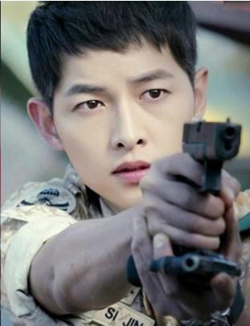
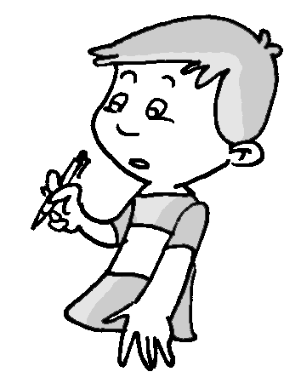
What does your favorite actor look like?
______________________________
He is tall. He has short black hair.

Slide 18
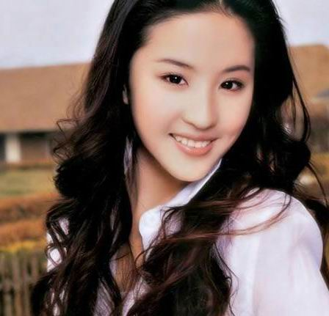
What does your favorite actress look like?
________________________________
________________________________
She is of medium height. She is a little thin. She has long curly hair.

Slide 19
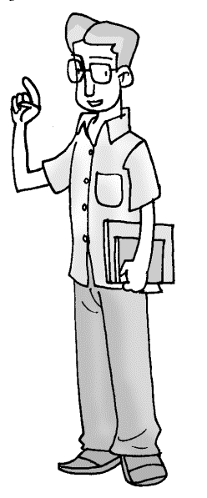
What does your favorite teacher look like?
__________________________________
__________________________________
He is really tall. He is a little thin. He has short straight hair.

Slide 20
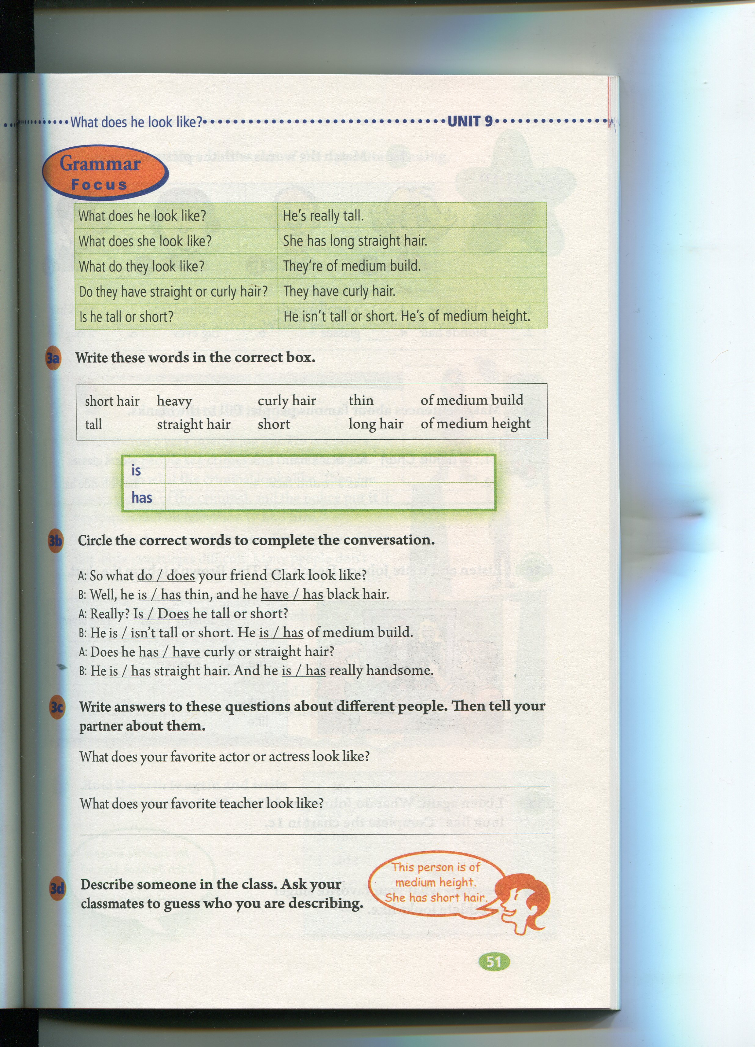
3d. Describe someone in the class.
Ask your classmates to guess who
you are describing.

Slide 21

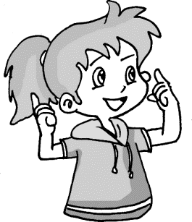
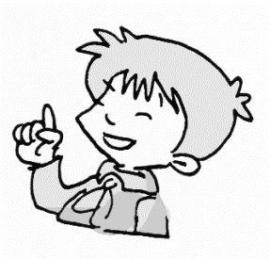
She is tall. She is a little thin. She has long straight hair.
Does she wear glasses?
I know. It’s Li Ling.
No, she doesn’t.

Slide 22
He’s very handsome. He’s tall. He wears a pair of glasses.
Does he have straight hair or curly hair?
He has curly hair.
Yes. You’re right.
Is it Wu Feng?

Slide 23
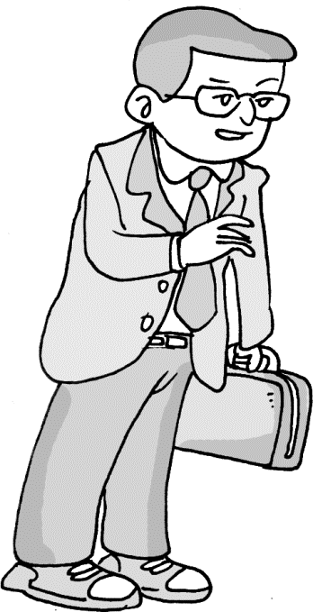
Practice
Look at the picture, and describe him/her.
He is __ ________ height. He has _____ _______ hair. He wears a pair of ________.
of medium
short straight
glasses

Slide 24
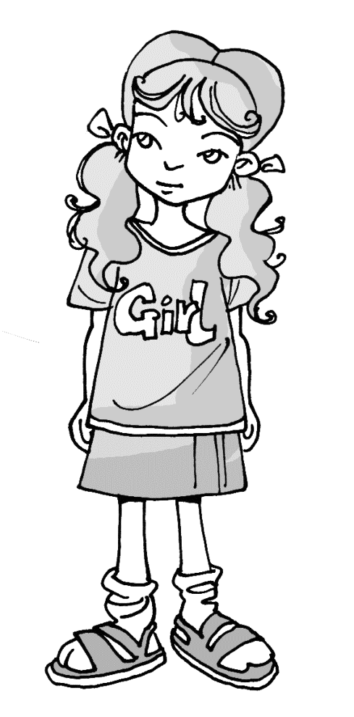
She is ______.
She has _____ _____ hair.
She is a _____ _____.
She ______ a T-shirt and a skirt.
tall
long curly
little thin
wears

Slide 25
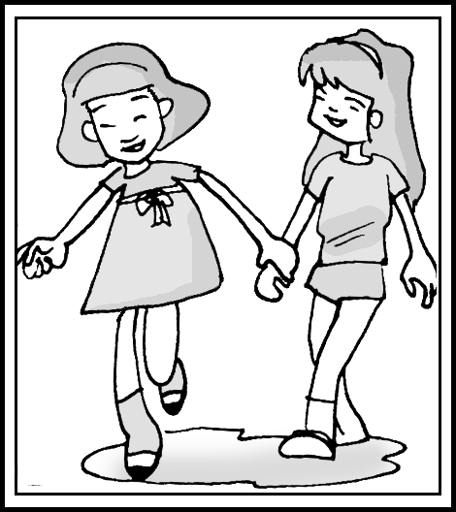
They are not ____ or _____. They are ___ _______ height. Jenny ____ _____ hair. But Linda has _____ hair. Their hair is straight.
They don’t _____ ________.
tall short
of medium
has
short
long
wear glasses
Jenny
Linda

Slide 26
Language Points
1. What does he look like?
他长得什么样子？
1) like可以用作及物动词, 意思为“喜欢”，
后面可以接名词或代词作宾语。
e.g. I like my family. 我喜欢我的家庭。
Do you like him? 你喜欢他吗？

Slide 27
2) 但在这个单元里like是介词, 意思为“像”，
“像……一样”。
e.g. He is like his father. 他像他的父亲。
The clouds in the sky are like cotton.
天上的云彩像棉花。
look like 看起来像……
e.g. That man looks like a teacher.
那个人看起来像个老师。

Slide 28
要询问“某人长得什么样子”就应该用下面
这个句型。“What does … look like?”
回答就应说出某人长相的特征：
e.g. He is very tall. 他个子很高。
She has long hair. 她头发很长。
He is short and fat. 他又矮又胖。

Slide 29
2. He isn’t tall or short.
他不高也不矮。
英语中在受到否定概念限定的部分一般不
用and，而用or。这里的or相当于and not。
如：I don’t have any brothers or sisters.
我没有兄弟姐妹。
注意这里用的是 or 而不是 and。

Slide 30
3. He has brown hair and wears glasses.
他的头发是棕色的而且戴着眼镜。
wear 动词, 可表示“戴着眼镜”, “蓄着……
样的头发”, “穿着……样的衣服”等。
wear的宾语是“衣服、鞋子、眼镜”等。
wear 表示经常性的状态。
put on表示穿的动作。

Slide 31
wear用进行时态时表示短时间内的状态。
e.g. She wears sports shoes every day.
她每天穿着运动鞋。
Mr. Brown wears glasses.
布朗先生戴着眼镜。
Miss Li is wearing a new dress today.
李老师今天穿着一件新裙子。

Slide 32
He is really handsome.
handsome 表示“英俊、潇洒、帅气”多
用于形容男性。
a handsome boy 一个英俊的男孩。
描述人长相好看的词语还有很多，如：
good-looking、beautiful等。但是good-
looking与beautiful 的用法是有区别的：

Slide 33
1) beautiful 可以指一个人的“外在美”，
也可指“心灵美”。
除了指人(女性), 还可以指物。
e.g. She is a beautiful girt.
她是个漂亮的女孩。
The flowers are very beautiful.
那些鲜花很美丽。

Slide 34
2) good-looking 指(外表上)看上去
“令人愉快的, 好看的, 漂亮的”, 可指男孩,
也可指女孩。
e.g. He is a good-looking boy.
他是一个漂亮的小男孩。
ordinary-looking 相貌平平的
ugly-looking 相貌不好看的,相貌丑的

Slide 35
Quiz

Slide 36
选择is或has完成下列句子。
1. Lily _____ short and ____ curly hair.
2. Tim ____ tall, and his sister ____ of
medium height.
3. Lucy _____ beautiful long black hair.
4. Mike _____ curly black hair and he
_____ very thin.
is has
is is
has
has
is

Slide 37
根据汉语完成下列英语句子。
1. — 玛丽长什么样？
— 她高个子，留着长发。
— What does Mary ______ _____?
— She’s _____ _____ long hair.
2. 我爸爸中等个子，短头发，戴眼镜。
My father is ____ ________ _______
with ______ _____ and ________.
3. 琳达是一位中等身高，留着长卷发的女
孩。
Linda is a girl of ________ ________ and
she _____ _____ ______ hair.
look like
tall with
of medium height
short hair glasses
medium height
has long curly

Slide 38
Translate and write them down.
1. 她总是留一头长直发。
2. 她长得漂亮但有些内向。
3. 他很帅。
4. 他留着卷发还是直发？
She always has long straight hair.
She’s good-looking but she’s a little bit quiet.
He is really handsome.
Does he have curly or straight hair?

Slide 39
Fill in the blanks with proper words.
There are four people in Tony’s family. His father _____(have/has) black hair. He _____(is/isn’t) tall or short. His mother _____(is/has) curly hair. His sister ____(is/has) straight hair. She ____(is/has) thin.
has
isn’t
has
has
is

Slide 40
Homework
Remember the sentences in the
Grammar Focus.
2. Describe five classmates in your
class in English.

Slide 41
Thank You!

